Slide 1
Testing and Safety Regulations for Hazardous Drug Compounding
Charlie Pellegrini
Clean Air Director
Energy Plus Scientific
Harrisburg, PA

Slide 2
What Standards do we Utilize?
United States Pharmacopeia (USP)
International Organization for Standardization (ISO)
Institute of Environmental Sciences and Technology (IEST)
Controlled Environmental Testing Association (CETA)
National Sanitation Foundation (NSF)

Slide 3
United States Pharmacopeia (USP) What is it?
The United States Pharmacopeia (USP) is a non-governmental, official public standards-setting authority for prescription and over-the-counter medicines and other healthcare products manufactured or sold in the US.
USP sets standards for the quality, purity, strength, and consistency of these products—critical to the public health.
The 1938 Food, Drug, and Cosmetic Act designated the USP as official compendia for drugs marketed in the U.S. and assigned the FDA legal authority to enforce the standards.

Slide 4
What is USP Chapter 797?
Effective January 1, 2004, USP 797 became the first official, enforceable requirements for sterile compounding.
It has rapidly become the US standard for compounding, transportation, and storage of compounded sterile products.
USP Chapter 797 is about three things – (1) Control of the compounding environment. (2) Control of compounding personnel. (3) Control of the compounding process.
Often, standards are created as the “lowest common denominator”. On the contrary, USP 797 strives for “best practice” in sterile compounding.
The goal of USP Chapter 797 is to protect patients from harm associated with contaminated or improperly prepared sterile products.

Slide 5
Hazardous Drugs as CSPs
Occupational exposure to HD can result in:
Acute effects, such as skin rashes
Chronic effects, including adverse reproductive events
Possibly cancer
Hazardous drugs SHALL be prepared for administration only under conditions that protect the healthcare worker and other personnel in the preparation and storage areas. Hazardous drugs SHALL be stored separately from other inventory in a manner to prevent contamination and personnel exposure.
Note: Many hazardous drugs have vapor pressures that allow volatilization at room temp; thus storage is preferably within an area such as a negative pressure room.

Slide 6
Hazardous Drugs as CSPs (cont.)
The storage area SHOULD have sufficient general exhaust ventilation, at least 12 air changes per hour.
HD SHALL be handled with caution; using chemotherapy gloves during receiving, distribution, stocking, inventorying, preparation for administration, and disposal.
Access SHALL be limited to areas where drugs are stored and prepared to protect persons not involved in drug preparation.

Slide 7
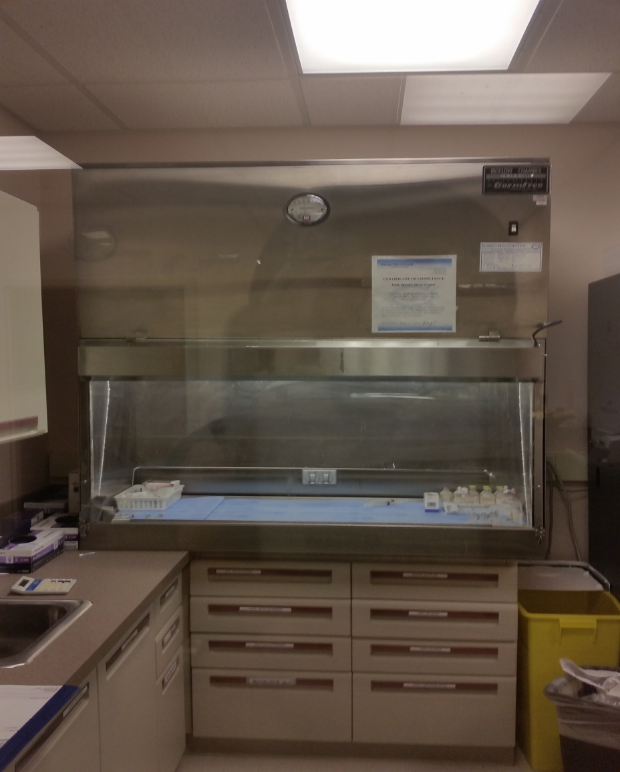
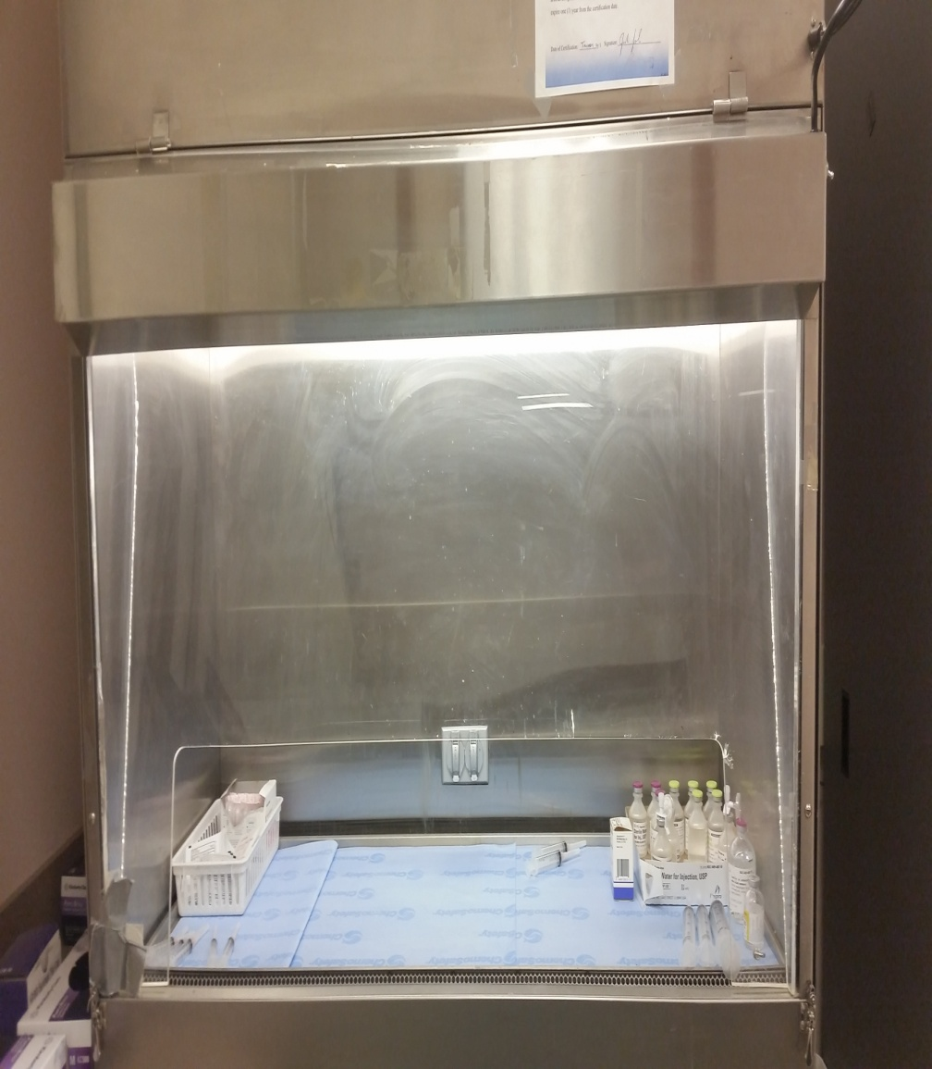
Hazardous Drugs as CSPs (cont.)
All HD SHALL be prepared in a BSC or a CACI.

Slide 8
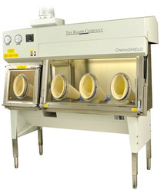
Hazardous Drugs as CSPs (cont.)

Slide 9
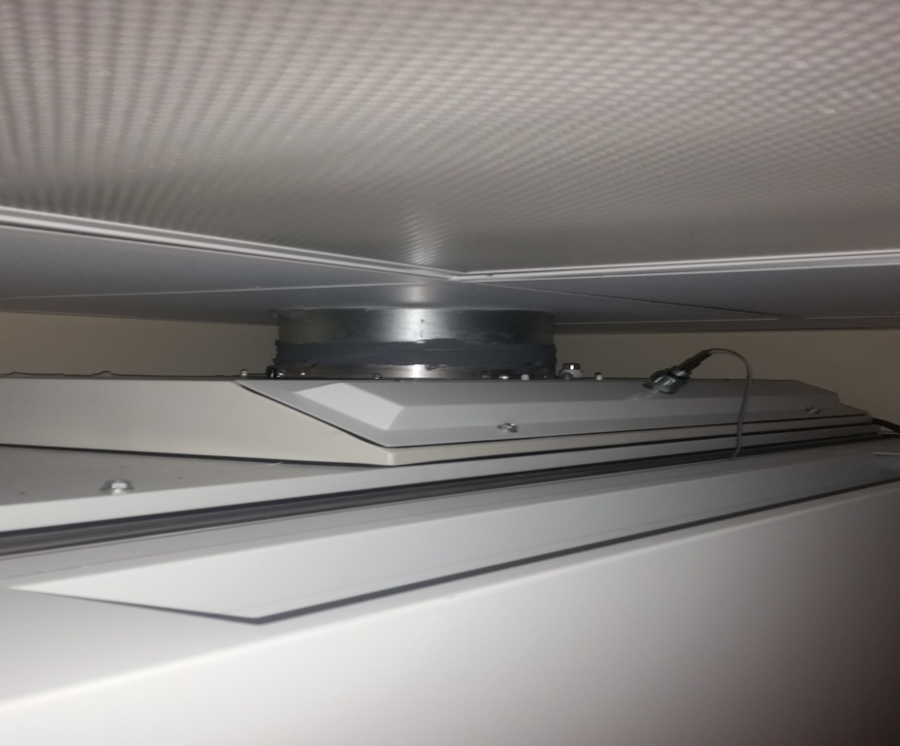
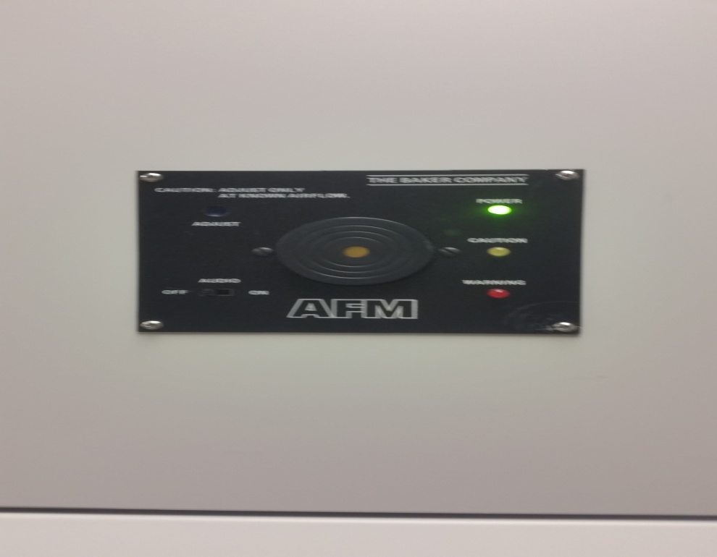
Hazardous Drugs as CSPs (cont.)
The BSC or CACI SHALL be 100% vented to the outside air through HEPA filtration.
An airflow alarm SHALL be installed as it serves a crucial function; the protection of the technician from a potentially hazardous loss of containment. Must be an audio/visual alarm.

Slide 10
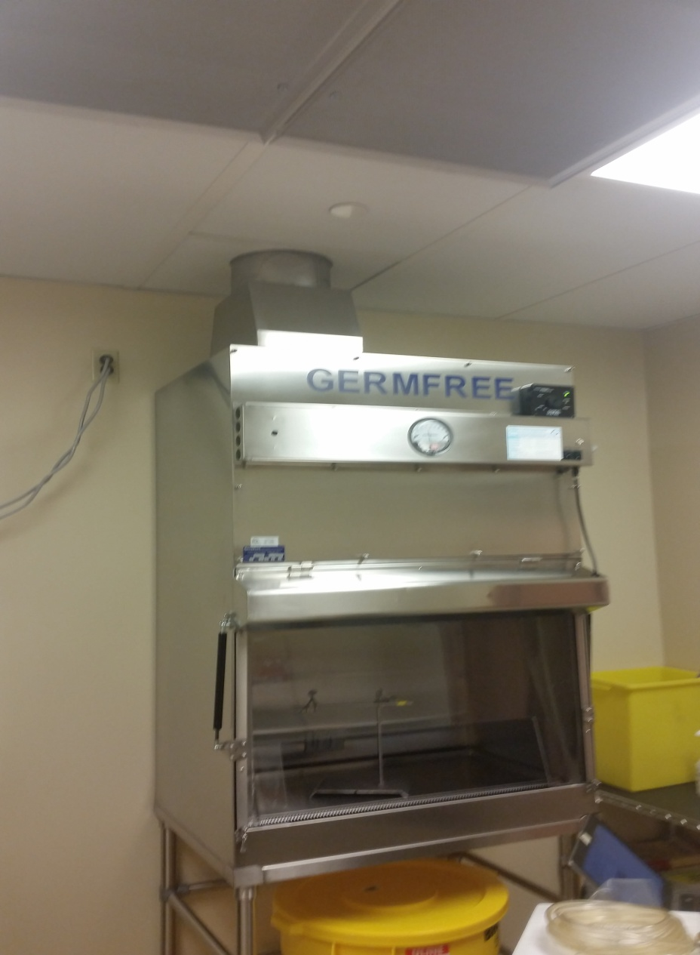
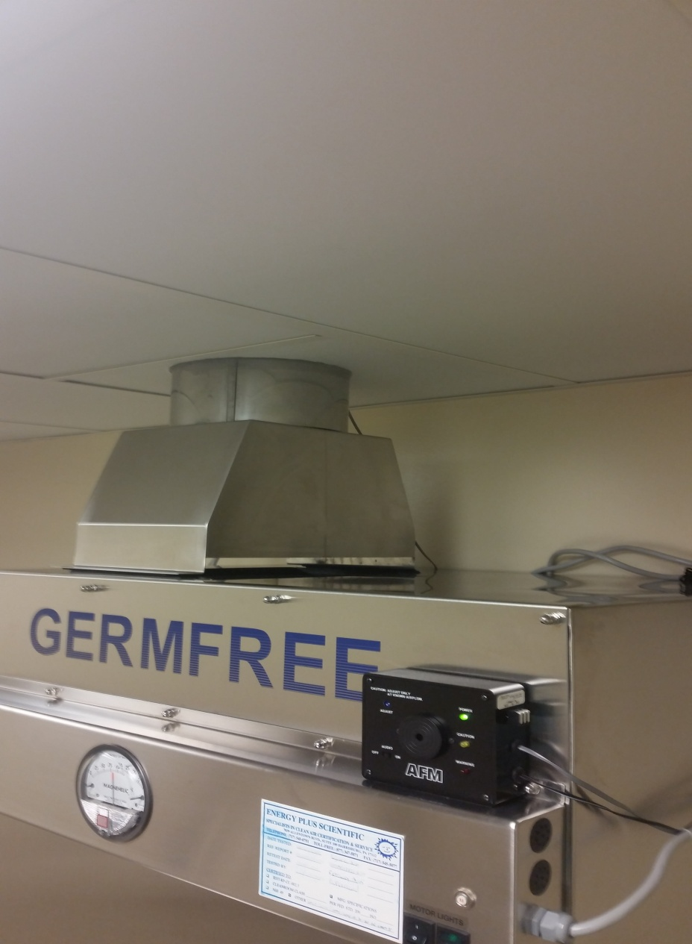
Hazardous Drugs as CSPs (cont.)

Slide 11
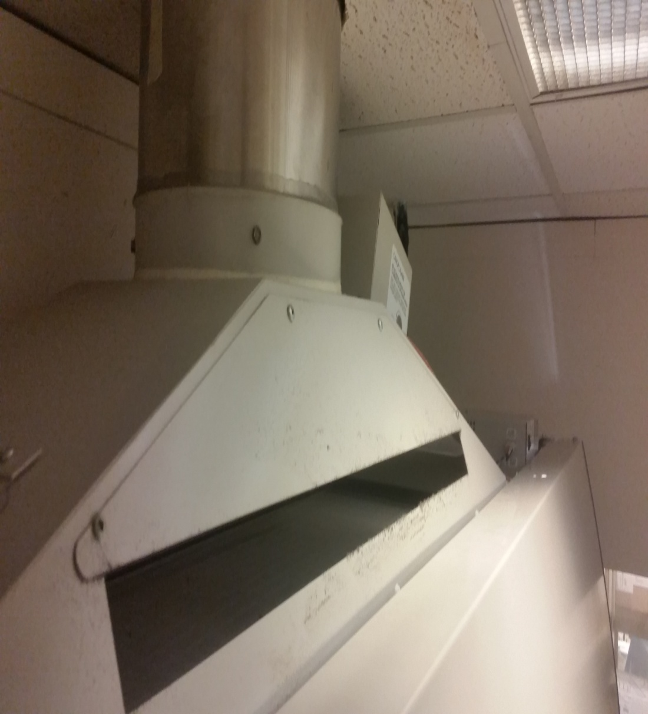
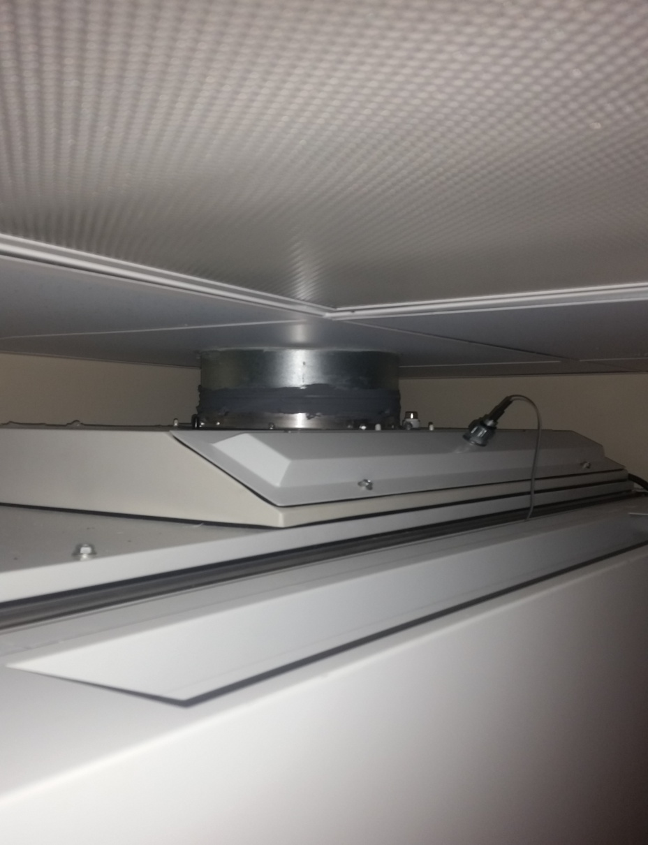
Hazardous Drugs as CSPs (cont.)

Slide 12
Hazardous Drugs as CSPs (cont.)
The ISO Class 5 BSC or CACI SHALL be placed in an ISO Class 7 area that is physically separated and has not less than 0.01-inch water column negative pressure to adjacent areas.
A pressure indicator SHALL be installed that can be readily monitored for correct room pressurization.
Note: If a CACI that meets the requirements of USP 797 is utilized outside of a buffer area, the compounding area shall maintain a minimum negative pressure of 0.01” and have a minimum of 12 ACPHs.

Slide 13
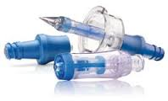
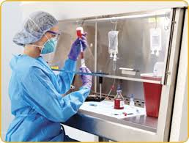
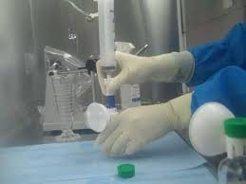
Hazardous Drugs as CSPs (cont.)
When closed-system transfer devices (CSTD) are used, they SHALL be used within an ISO Class 5 BSC or CACI.
Note: In facilities that prepare a low volume of hazardous drugs, the use of two tiers of containment (e.g., CSTD within a BSC or CACI that is located in a non-negative pressure room) is acceptable.

Slide 14
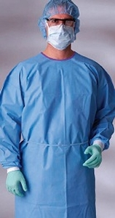
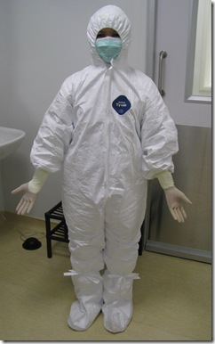
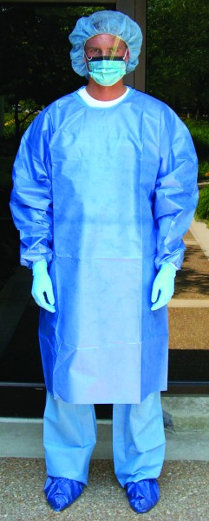
Hazardous Drugs as CSPs (cont.)
Appropriate personnel protective equipment (PPE) SHALL be worn when compounding in a BSC or CACI. PPE SHOULD include gowns, face masks, eye protection, hair covers, shoe covers, and double gloving with sterile chemo-type gloves.

Slide 15
Hazardous Drugs as CSPs (cont.)
All personnel who compound HDs SHALL be fully trained in the storage, handling, and disposal of these drugs.
Training SHALL occur prior to preparing or handling hazardous CSPs, and its effectiveness SHALL be verified by testing specific HD preparation techniques. Such verification SHALL be documented for each tech at least annually.
Compounding personnel of reproductive capability SHALL confirm in writing that they understand the risk of handling HDs.

Slide 16
Hazardous Drugs as CSPs (cont.)
The training SHALL include at least the following:
Safe aseptic manipulation practices
Negative pressure techniques when utilizing a BSC or CACI
Correct use of CSTD devices
Containment, cleanup, and disposal procedures for spills
Treatment of personnel contact and inhalation exposure
Disposal of all hazardous drug wastes SHALL comply with all applicable federal and state regulations.

Slide 17
Achieving a State of Control
Hand Hygiene, Garbing, Aseptic Technique
Training
Facility design
Environmental Sampling
Cleaning
Standard Operating Procedures
Sterilization, Quality Release Checks

Slide 18
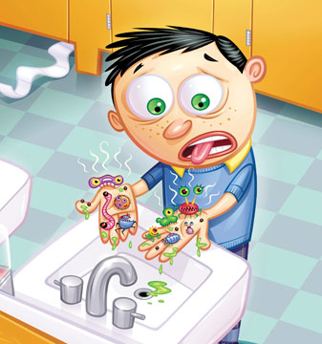
Hand Hygiene
Hand washing is defined as the vigorous, brief (30 seconds) rubbing together of all surfaces of lathered hands, followed by rinsing under a stream of water.

Slide 19
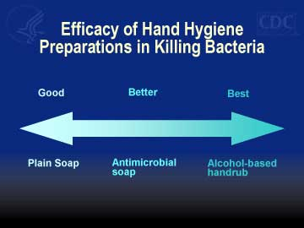
Hand Hygiene

Slide 20
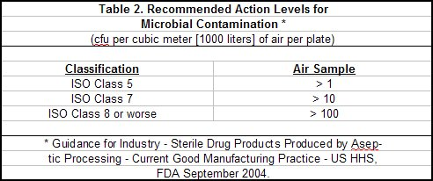
Environmental Sampling
Designed to demonstrate that the primary and secondary engineering controls, disinfecting procedures, and work practices result in a suitable environment for compounding.
A sampling plan SHALL be implemented for airborne viable particles within each ISO Class 5 PEC and other areas in close proximity to the PEC during the certification process. This is for CSPs with 12 hour or less BUD.
Air sampling SHALL be performed at least semi-annually as part of certification.

Slide 21
Environmental Sampling(cont.)
Regardless of the number of cfu identified in the pharmacy, further corrective actions will be dictated by the ID of the microorganisms (at least to the genus level)
Highly pathogenic organisms (e.g., gram-negative rods, coagulase positive staph, molds and yeasts) can be potentially fatal to patients receiving CSPs and must be immediately remedied.
NECC meningitis outbreak 2012
CDC traced outbreak to fungal contamination to steroid injections
Spanned to 75 facilities in 23 states, about 14,000 patients
As of Sept. 2012, 64 deaths and 751 injured
Glenn Chin, charged with improper techniques, unsafe practices, falsified cleaning logs & ordered techs to mislabel vial

Slide 22
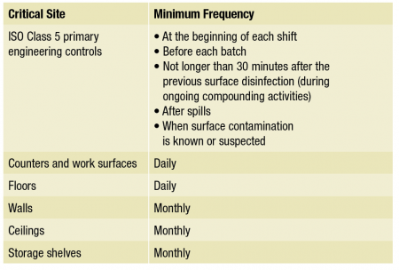
Cleaning and Disinfecting
Environmental contact is a major source of microbial contamination of CSPs.

Slide 23
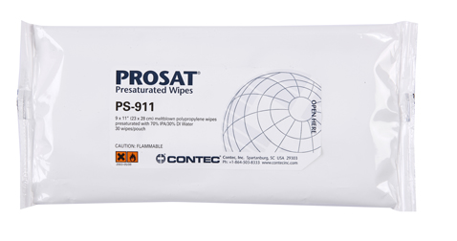
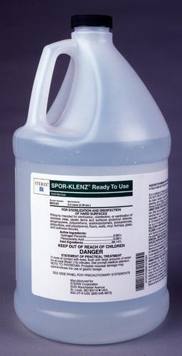
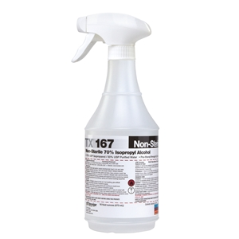
Cleaning and Disinfecting(cont.)
Surfaces in PECs require disinfecting more frequently.
Items SHALL be removed from all areas to be cleaned.
Utilize lint-free or non-shedding wipes with 70% IPA.

Slide 24
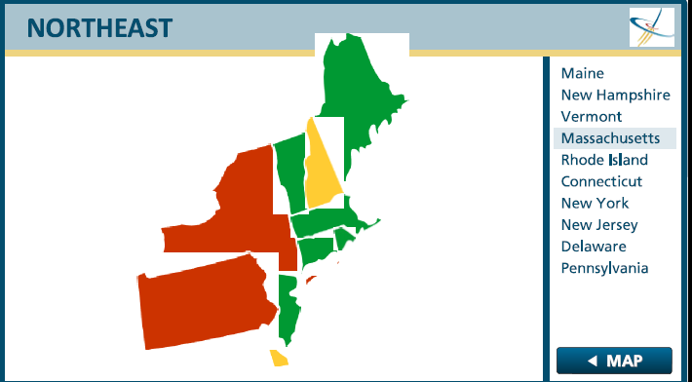
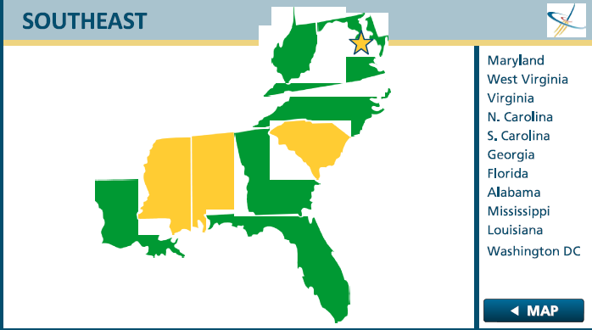
So, Do I Need to Comply?

Slide 25
So, Do I Need to Comply?(cont.)

Slide 26
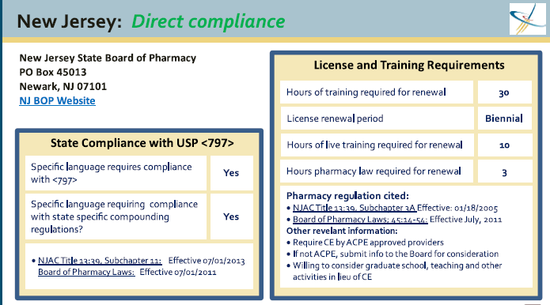
So, Do I Need to Comply?(cont.)

Slide 27
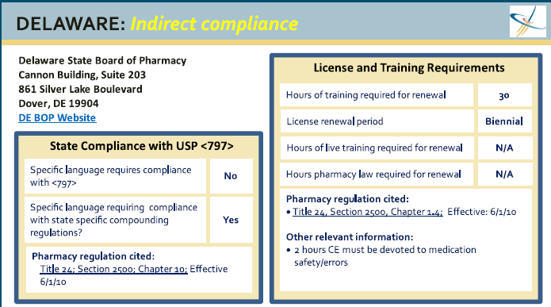
So, Do I Need to Comply?(cont.)

Slide 28
USP<797> vs. USP<800>
USP<800> Hazardous Drugs-Handling in Healthcare Settings
New chapter created to identify the requirements for receipt, storage, mixing, preparing, compounding, dispensing, and administration of hazardous drugs to protect the patient, healthcare personnel, and environment. Facility requirements that differ from general chapter <797> and this chapter will be harmonized. These differences include the following:
Elimination of the current allowance of low volume compounding.
Allowance for a Containment Segregated Compounding Area, a separate, negative pressure room with at least 12 ACPH for use with compounding HDs. Low- and medium-risk HD CSP may be prepared in a BSC located in a C-SCA, provided the BUD of the CSP does not exceed 12 hours.

Slide 29
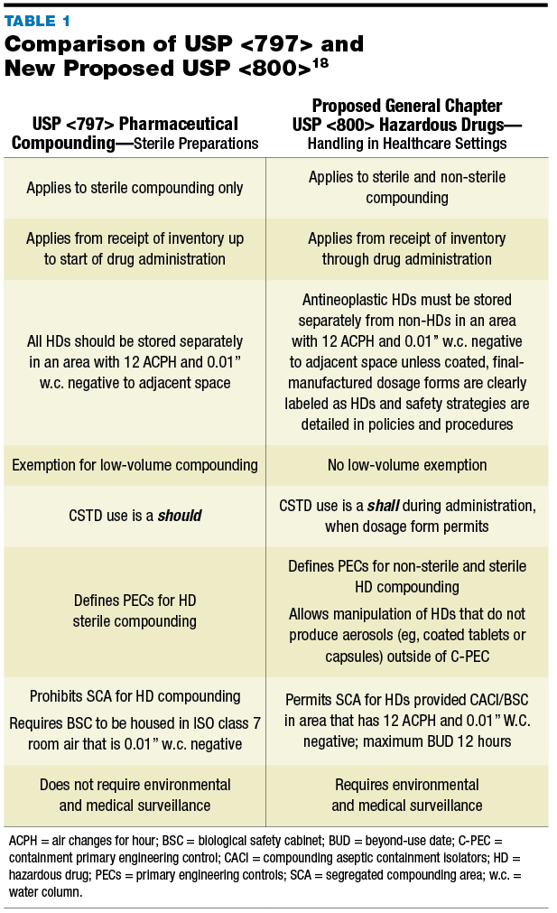
USP<797> vs. USP<800>(cont.)

Slide 30
Conclusion
Do we have the proper PECs and PPEs in place?
Are we utilizing the correct test procedures?
Is patient safety in jeopardy? Technician safety?
How are our cleaning procedures?
Do we have SOPs in place?
https://www.youtube.com/watch?v=UgTYIswJ9i8#action

Slide 31
Abbreviations & Acronyms
ACPH air changes per hour
BSC biological safety cabinet
BUD beyond-use date
CACI compounding aseptic containment isolator
CFU colony-forming unit
CSP compounded sterile preparation
CSTD closed-system vial-transfer device
FDA food and drug administration HD hazardous drug
IPA isopropyl alcohol
PEC primary engineering control
PPE personnel protective equipment

Slide 32
Questions

Slide 33
Websites
http://www.cdc.gov/niosh/topics/hazdrug/
http://www.cdc.gov/niosh/docs/2014-138/pdfs/2014-138.pdf
https://www.osha.gov/SLTC/hazardousdrugs/
http://www.usp.org
http://www.usp.org/sites/default/files/usp_pdf/EN/m7808.pdf
http://www.cetainternational.org/
http://www.nsf.org/services/by-industry/pharma-biotech/biosafety-cabinetry/

Slide 34
Acknowledgements
Quotes from USP are copyrighted information owned by USP.

Slide 35
References
Current U.S. Pharmacopeia <797>
Briefing of U.S. Pharmacopeia <800>
Controlled Environment Testing Association Compounding Aseptic Guidelines

Slide 36
Contact Information
Charlie Pellegrini
Clean Air Director
Energy Plus Scientific – Division of Energy Plus Inc.
Harrisburg, PA
1-877-347-5871
cpellegrini@egplus.com

